Slide 1
Is Wyoming’s Gender Wage Gap A Myth?
Or Can We Have Equal Pay for Equal Work in Wyoming?
© Wyoming Women’s Action Network, 2019
Notes:
First, thank you to all of you for coming out to this great event. And thank you to the organizers. Can we have a hand for the organizers? Putting this event on annually in celebration of Women’s History Month.
Thank you for having me today. I am excited to have the chance to talk with you about the gender wage gap and to address what seems to be a perennial question – especially in the Legislature – is the gender wage gap a myth? And I’ll leave some time for questions at the end.
As we head into today’s conversation about the gender wage gap, it is essential to understand that:
This is about women’s economic security.
This is about Wyoming’s economic development.
This is about whether each and every person who works for a living gets equitably compensated for that work and has enough money to buy groceries, pay rent, go to the doctor, invest in their community, save for their future.
This is really an economic issue at its core and it has a lot of impact on Wyoming’s future. So let’s talk about the wage gap.

Slide 2
Common Myths
#1: The gender wage gap doesn’t exist
#2: The gender wage gap comes from comparing higher paying and lower paying jobs
#4: The gender wage gap exists but there is nothing we can do about it
#3: The wage gap is a phenomenon that exists because women make different choices
© Wyoming Women’s Action Network, 2019
Notes:
In fact, there are several gender wage gap myths. Here are the four most common ones.
#1: The gender wage gap doesn’t exist
#2: The gender wage gap comes from comparing higher paying and lower paying jobs
#3: The wage gap is a phenomenon that exists because women make different choices
#4: The gender wage gap exists but there is nothing we can do about it
Let’s dive right in and talk about what the wage gap is and see if we can peel back some of these layers.

Slide 3
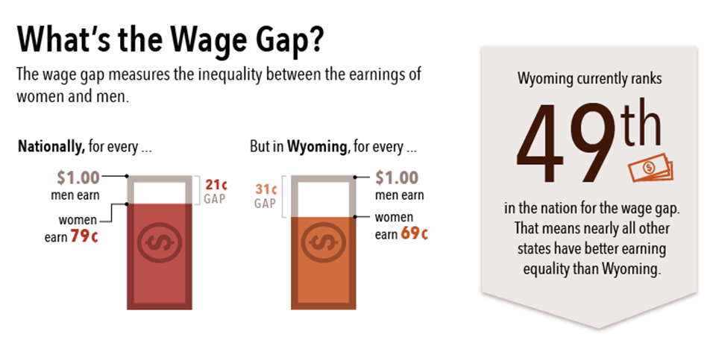
Wyoming’s Data
© Wyoming Women’s Action Network, 2019
Notes:
The wage gap measures the inequality between the earnings of men and women. And whether you look at hourly, weekly, or annual earnings, there is always a wage gap. I’d also like to point out that the “men” and “women” that are used as normative here are white men and white women.
Nationally, for every $1 that white men earn, white women earn 79¢. But in Wyoming, for every $1, women earn 69¢. Nationally, mothers fare about the same as women in Wyoming when compared to fathers. And women of color fare even more poorly in some cases, based on race and ethnicity. But the standard measure, and the one we’ll use here is 69¢ to the dollar.
So there we were, ranked 49th, which was, actually, an improvement over prior years where the headline was “Wyoming: Worst for Women.” Now, we’re out of the basement (Louisiana is behind us) and trending in the right direction. And, because people are beginning to understand that this is about women’s economic security AND Wyoming’s economic development, we have reason to believe that it will continue to get better.
Analysis into select characteristics found significant differences in the pay gap. The disparity was significantly less for females with bachelor's degrees. Females who work in the healthcare and social assistance sectors experience a larger pay gap.
Wyoming’s gender wage gap varies by county of employment. In Wyoming’s two most populated counties, Laramie and Natrona, women were paid $0.80 and $0.82 on the dollar, respectively. Counties in which mining made up a substantial proportion of all jobs had some of the largest wage gaps, including Sweetwater ($0.59 on the dollar), Sublette ($0.62), and Campbell ($0.66) counties. Niobrara ($0.99 on the dollar) and Goshen ($0.90), two of Wyoming’s least populated counties, had two of the narrowest gaps.
The wage disparity was narrower for many occupations within the educational services industry. Women earned $0.88 for every dollar earned by men in the educational services sector in total. In some cases, women out-earn men in this field. For example, female kindergarten teachers earn $1.14 on a man's dollar.

Slide 4
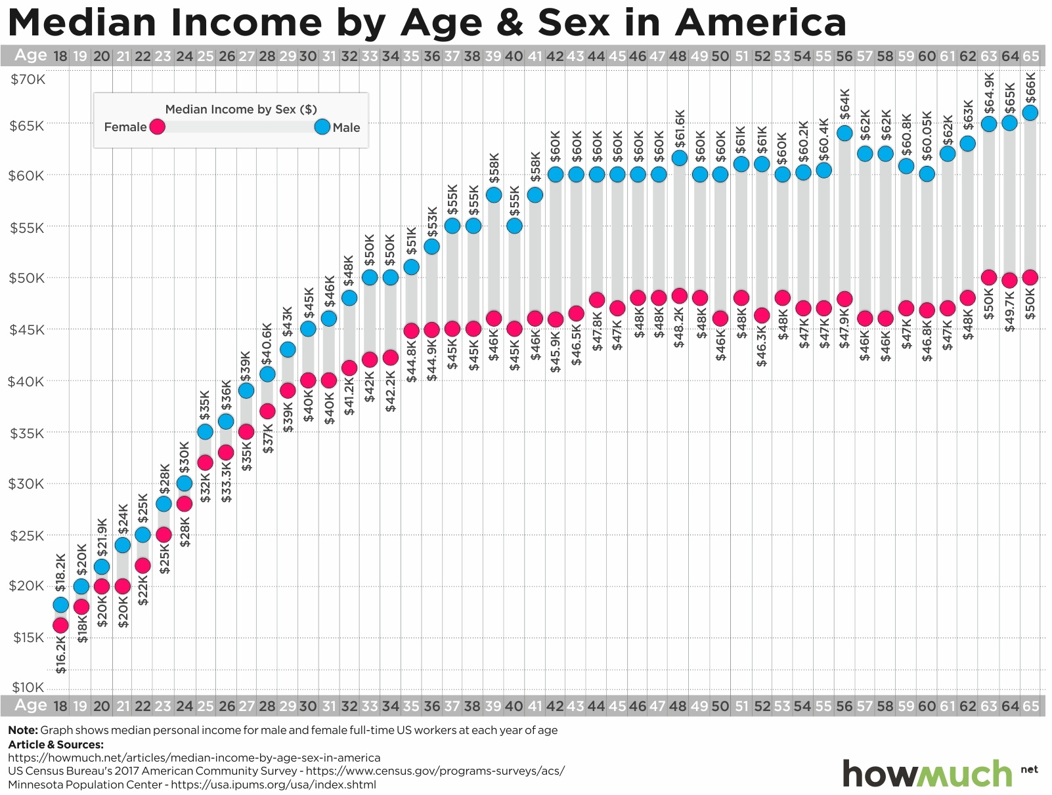
Gender
Wage Gap
By Age
© Wyoming Women’s Action Network, 2019
Notes:
In this slide, the red dots are women, the blue are men. And this explores the issue by age. For all of our so-called “working lives” from ages 18-65, men earn more than women. At some ages, those amounts are closer together, but they widen over time and the gap never closes. This has all kinds of economic implications, for individual women and for the communities we live in. And it is especially significant as we age: women live longer than men and we have earned less over time. Which means that most women are aging into poverty. We have to consider this as we talk through the economic implications of the wage gap.

Slide 5
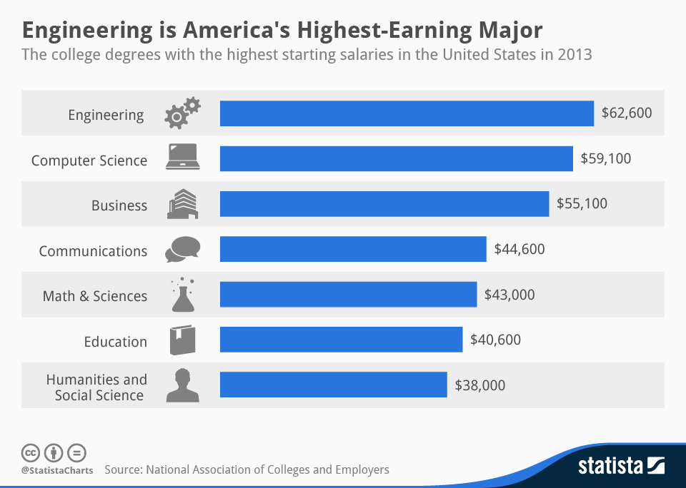
Compensation by Job Type
© Wyoming Women’s Action Network, 2019
Notes:
So how is it measured? What are we looking at when we say that men earn more than women? There is a common fallacy that we’re comparing apples to oranges. One of our state Reps talked about it this way during the Legislative Session. He said, engineers earn more than social workers. And, look at this chart: It is exactly true. Engineering is one of the highest paid professions. Social work is one of the lowest. He said, more men are engineers and more women are social workers. That is 100% true, too. There are more men in engineering and more women in social work. So he came to the conclusion: If you’re comparing men in engineering to women in social work, of course you get a gender wage gap. And he is right – and also wrong. That is not what we’re comparing.

Slide 6
Compensation by Sector
© Wyoming Women’s Action Network, 2019
Notes:
THIS. This is what we’re comparing. When we do the research, what we’re comparing is apples to apples. Men and women in the same professions, with substantially similar jobs, who have comparable education, skills, and experience. So the gender wage gap tells us what is happening within a sector. Within engineering, when we look at engineers who have worked the same amount of time in the field, we can see the wage gap. Once again, women are red and men are blue. There is a wage gap that widens over time.

Slide 7
Bonus by Sector
© Wyoming Women’s Action Network, 2019
Notes:
Tellingly, there is also a significant gap in bonuses in the field that widens over time.
Again, women are in red, men are in blue. And what starts out close together widens over time. There is clearly a perception in all fields that men are more valuable workers. Which we’ll talk more about.

Slide 11
Notes:
So, there is a wage gap, we arrive at it by comparing apples to apples - people in the same profession who have the same education, skills, experience, and are doing substantively similar jobs. So the third myth is, hey, the wage gap exists but it is because women make different choices. There is considerable evidence of barriers to free choice of occupations, ranging from lack of unbiased information about job prospects to actual harassment and discrimination, especially in male-dominated jobs. In a world where half of engineers and half of social workers were men, men and women might “choose” very differently than they do now. Within this myth around choice, there is a myth around negotiation.

Slide 12
Do Women Negotiate?
Millennials
Gen X’ers
Baby Boomers
© Wyoming Women’s Action Network, 2019
Notes:
The prevailing wisdom has long been that part of the gender wage gap is due to the belief that women don’t ask for raises or negotiate for pay as often as men do. In fact, a 2003 book on the subject – titled Women Don’t Ask – popularized this notion. Lean In reinforced it. The idea is that women have the power to close the wage gap, we just need to step up and do it. And while there is no doubt that negotiating is essential – and you should do it! and learn how to do it if you don’t already do it – it turns out that women do ask. In fact, growing percentages of women ask for raises. That big blue pie slice represents women ages 25-34. They ask. But they don’t get. Women get raises less often than men and, when we do get raises, we only get about 75% of what men get. That adds up over time.

Slide 13
Women Ask. But Don’t Get Raises.
© Wyoming Women’s Action Network, 2019
Notes:
Women get raises less often than men and, when we do get raises, we only get about 75% of what men get. That adds up over time.

Slide 14
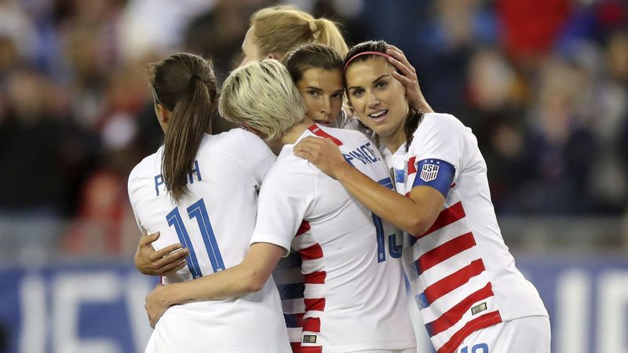
Negotiation: US Women’s National Soccer Team
© Wyoming Women’s Action Network, 2019
Notes:
Here’s a great example of some millennial women negotiating: The US Women’s National Soccer Team. By every single objective measure, they outperform their male counterparts: fans, attendance, merchandise sold, ticket sales, wins, medals, World Cups, games played, amount of practice and practice games. Everything. And yet. In spite of the performance, in spite of the negotiation, they are earning significantly less. When you compare what US men’s and women’s National Soccer Players earn for their appearances, the women earn as little as 38% of what the men earn.

Slide 15
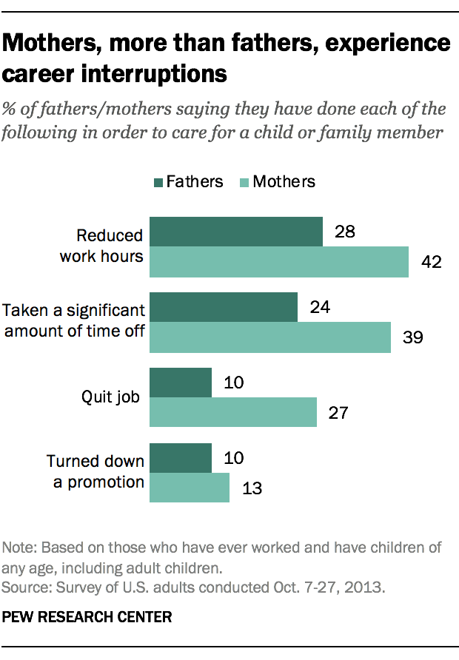
Caregiving Penalty
© Wyoming Women’s Action Network, 2019
Notes:
The next area of the myth that women make different choices is around caregiving. The argument is that women choose to work lesser jobs or fewer hours or negotiate for more flexibility rather than more pay. And the assumption is that this is a valid choice rather than a compelled necessity. In fact, about 2/3 of women are in the workforce but 80% of women report that they WANT to be in the workforce.
“A number of factors are blocking equality in employment, and the one playing the largest role is caregiving,” said Manuela Tomei, Director, ILO Conditions of Work and Equality Department. “In the last 20 years, the amount of time women spent on unpaid care and domestic work has hardly fallen”, she said, while men’s participation has increased “by just eight minutes a day. At this pace of change it will take more than 200 years to achieve equality in time spent in unpaid care work.” Ultimately, this leads to a caregiving penalty. Mothers, more than fathers, experience career interruptions. And, mothers, more than fathers experience a caregiving penalty as a result.
And when you look at this chart, you can see how that would be the case: there is a caregiving penalty for women. And it affects women more than men. According to this research from the Pew Research Center, women have had to reduce their work hours, take time off work, quit their job, or turn down promotions in order to care for a child or family member.

Slide 16
Discrimination & Unconscious Bias
© Wyoming Women’s Action Network, 2019
Notes:
And what kind of environments are we working in? Roughly 4 in 10 working women say they’ve experienced gender discrimination at work. This ranges from earning less for doing the same job to being denied a promotion. In fact, in every study done nationally, some of the gender wage gap can be accounted for, but as much as 7¢ cannot. In Wyoming, the researchers found 13¢ they could not account for. There is no way to know what to attribute this to definitively, but given the prevalence of women describing discrimination at work, we might infer discrimination or, at least, unconscious bias.

Slide 17
Nineteen years after her first day at Goodyear, Lilly received an anonymous note revealing that she was making thousands less per year than the men in her position.
© Wyoming Women’s Action Network, 2019
Notes:
Lilly Ledbetter is an example of this that many of you may have heard of. She was an employee at Goodyear who found out 19 years into her job that she was making thousands less than men in the same position. She uncovered discrimination thanks to an anonymous tip. She helped to change the laws to enable women to have more tools to combat discrimination when it is present in the workplace.
And that leads directly to the how we address the fourth myth: That there is a gender wage gap but there is nothing that we can do about it. In fact, there is a lot that we can do about it. I like to talk about this as a three-legged stool – and we need all three legs of the stool. Addressing the gender wage gap has to include the private sector, government, and individual responsibility.

Slide 18
What Can Private Industry Do?
Conduct Salary Audits
Publish Compensation Charts
Provide HR Training
“Pay equity is no longer a defensive conversation, but a badge of honor critical to attracting & retaining top talent.”
Quote: Natasha Lamb, Arjuna Capital, named by Bloomberg Businessweek as one of the “Bloomberg 50” who defined global business in 2017.
© Wyoming Women’s Action Network, 2019
Notes:
Let’s start with what the private sector can do. What we’re hearing some of the leading players in the tech sector, especially, say is that. “Pay equity is no longer a defensive conversation, but a badge of honor critical to attracting and retaining top talent.” This is how execs in the global and tech and private industries are approaching this, these are the kinds of businesses that Wyoming wants to attract. And let’s take a look at what they ARE doing.
These businesses have begun to conduct (voluntary) salary audits: The leading example of this is the wildly successful tech company, Salesforce. Their founder, Marc Benioff, was approached by his Chief Human Resources Officer – a woman – who told him that they had a gender wage gap problem. He was so certain that they did not that he said to go ahead and do a salary audit. Well, you can tell where this is going. They had a gender wage gap that mirrored the national numbers. Women were paid between 10-20% less than men doing THE SAME WORK with the same skills and education. So they made a capital investment and remedied the situation. What they’ve also done is to articulate that this requires ongoing monitoring, so they reaudit.
Comp charts: not talking about individual salaries, talking about a transparent chart that describes compensation based on education, skills, experience
HR training: helps to rule out discrimination, ensure there is no unconscious bias. This is where that Salesforce example is really relevant again: sometimes, companies are not even aware of what is happening.

Slide 19
Example: Equal Pay Out Event
© Wyoming Women’s Action Network, 2019
Notes:
Fun local example of private industry reviewing and addressing. Kind and Queen of Corbet’s launched last year. Corbet’s is the same feature on the mountain and it sure doesn’t care if you are a man or a woman. Does not care. Yet the original pay out for the event offered a lot more money to the Kings than the Queens. Both men and women objected and they changed it right away. This is an equal pay out event. Mountain doesn’t change. Expectation of performance is the same. The compensation is, too. One more equal pay out example from sports: In figure skating, women’s figure skating generates revenue and men’s does not. Yet, they have made the decision to pay equal prize money. They say it is “the right thing to do.” Which it is.

Slide 20
What Can Government Do?
Transparent compensation (HB84)
Raise minimum wage (HB273)
Require factors for wage differences
Call for wage transparency (HB72)
Eliminate salary history (HB178)
Source: R&P Report on Wage & Benefit Disparities between Men & Women in Wyoming prepared by Wyoming Department of Workforce Services
© Wyoming Women’s Action Network, 2019
Notes:
Next leg of the stool is government.
Let’s talk about why each of these matters – and what the numbers next to them mean. Each of the numbers refers to a bill that was introduced in the Legislature this year (unfortunately, none of these bills passed). These are all recommendations that came from the Wage Disparity report from Workforce Services, these are all pieces of legislation that have been enacted in other states to positive effect.
Transparent compensation does NOT refer to publishing something that says that Jen Simon earns x and Adam Meyer earns y. What it means is that there are published salary strata, for example, if you have 5 years of experience and a bachelor’s degree, the salary range is x. If you have 10 years of experience and a master’s degree, the salary range is y. What this does is help prospective employees to know what your compensation ranges are and to remove some of the guessing game from the whole process for all employees.
Wage transparency simply means that employers cannot fire employees for talking about what they earn. Research shows that wage transparency creates more stable work environments, less turnover, higher job satisfaction, and, importantly, higher productivity.
Eliminating the question of salary history ensures that discrimination encountered in prior employment is not inadvertently replicated. If #1 is already in place, this is even less important because a prospective employee already knows what compensation looks like.
Raising the minimum wage is important for the gender wage gap because 2/3 of all minimum wage workers are women. This is true in Wyoming – the R&P report made this recommendation - as well as nationally. Anecdote about janitorial company.
The state already requires employers to prove that there are factors other than gender for wage differences - like experience, skills, education.

Slide 21
What Does Closing the Gender Wage Gap Mean for Wyoming?
An infusion of $153 million in labor income
An induced effect of an additional 604 jobs
Approximately $22.2 million in additional labor income
Over $80 million in output to the Wyoming economy
Increases to state and local taxes of more than $5 million.
Source: R&P Report on Wage & Benefit Disparities between Men & Women in Wyoming prepared by Wyoming Department of Workforce Services
© Wyoming Women’s Action Network, 2019
Notes:
What does this mean for the state? Well, as you can see – and this also comes from the Workforce Services Wage Disparity report – it means a lot for Wyoming’s economic development. Closing the gender wage gap means $153M in additional revenue for Wyoming. More labor output, more tax revenue. And more than 600 additional jobs. And, because of how women reinvest in communities, things like local doctors offices stand to see significant increases in income when women have more financial resources. This would be a huge boon to our local communities.

Slide 22
What Can You Do?
Education
Negotiation
Action
Advocacy
© Wyoming Women’s Action Network, 2019
Notes:
Which brings us to the third leg of the stool: What do we as individuals need to do to address the gender wage gap? What can we do?
First and foremost is education: learn more. Thank you for coming today to learn about this topic. Visit our website. Visit the Wyoming Women’s Foundation website. Read the R&P Report. Get the facts.
Negotiation: We’ve talked about how important it is to negotiate. I am firmly convinced that as more and more women negotiate, we can help dispel the myth that we do not ask for raises and, in turn, we will become more likely to get them. If you aren’t already negotiating or want to learn more about how to do it, a quick shout out to the American Association of University Women who teach excellent courses on negotiation, including a free, online course.
Once you have the facts and feel comfortable negotiating on your own behalf, consider some Advocacy: Ask questions, help with policy in your organization, inform your friends and neighbors and colleagues and family members about the issue.
And then take Action: Get involved in the public process, attend public meetings, comment at a public meeting, volunteer or apply for a public or state board, work on a campaign, or run for office!

Slide 23
What Does It Mean for You?
Approximately 133 more weeks or 2.6 years worth of groceries
14.6 more months of mortgage & utilities payments
24 additional months of rent
30.5 more months of child care
Four years of tuition & fees for a four-year public university
Source: National Partnership for Women and Families
© Wyoming Women’s Action Network, 2019
Notes:
Because, here is what this means for women in Wyoming. I want to close this talk reminding you that the gender wage gap is an economic security issue. And here’s how we know: These figures show what women in Wyoming could afford if we were to close the gender wage gap. 133 weeks of groceries, more than a year of mortgage and utilities, two years of rent, nearly 3 years of childcare, tuition and fees for UW. This represents a wholesale change in security for many women in our state. Closing the wage gap has a meaningful impact.
Here’s my parting shot: If women were paid the same as comparable men—men who work the same number of hours, are the same age, have the same educational attainment, urban/rural status, and live in the same region of the country—nearly 60 percent of women would see a pay increase, including almost two thirds of single mothers, and women’s poverty rate would be cut in half, including a decline in poverty for single mothers from 28.9 to 14.5 percent.
Again, this is about your economic security. This is about ensuring that equal work garners equal pay. This is about making Wyoming’s economy vital and vibrant for everyone in the state.

Slide 24
Thank You!
Jen Simon, MTS
Wyoming Women’s Action Network
wyomingwomensnetwork.com

Slide 25
Resources
Wyoming Women’s Action Network
Wyoming Women’s Business Center
Wyoming Women’s Foundation
University of Wyoming Department of Gender & Women’s Studies
American Association of University Women (AAUW)
Women’s Media Center
National Partnership for Women & Families
Institute for Women’s Policy Research
Narrow the Gap
www.wyomingwomensnetwork.com

